Slide 1
Enterprise Risk Management
Jyotin Mehta
Chief Internal Auditor - Voltas Limited
October 16, 2013

Slide 2

Risk awareness…….
CAN’T MANAGE WHAT YOU DON’T SEE!
Notes:
2

Slide 3

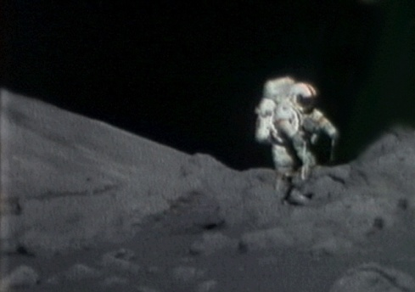
No Risk …
No Gain!

Slide 4

What is Risk?
Risk, in traditional terms, is viewed as a ‘negative’.
The Chinese give a much better description of risk
  The first is the symbol for “danger”, while
  the second is the symbol for “opportunity”, making risk a mix of danger and opportunity.
“Risk- let’s get this straight up front – is good. The point of Risk management is not to eliminate it; that would eliminate reward. The point is to manage it – that is, choose to place bets, where to hedge bets, and where to avoid betting together.” - Thomas A. Stewart

Slide 5
Risk & Risk Management
In economic terms, profit is the reward for entrepreneurship or “Risk Taking”
As a lay investor, our investment planning is based on risk perception – bank deposits, life insurance, debentures and GoI bonds, Mutual Funds, Shares, Private Equity….
Risk management is an attempt to identify, measure, mitigate and monitor risks.

Slide 6
Risk Management
Understand the nature and extent of risks facing the company
Understand the extent and categories of risks which are acceptable for a company or an enterprise
Understand the likelihood of risks concerned materializing
Company’s ability to reduce the incidence and impact on business of risks that do materialize
Costs of Mitigation

Slide 7
Classification of Risks
  Strategic
  A strategic risk is a risk that a company is exposed to when pursuing its business objectives, or likely loss arising from a poor strategic business decision. e.g. Over-dependence on one line of business or a failed acquisition
  Operational
  Operational risk as the risk of loss resulting from inadequate or failed internal processes, people and systems, or from external events. e.g. Frauds, foreign exchange volatility, disruption of business
  Compliance
  Risks arising from breach of law/ regulatory requirement. e.g. Non compliance in foreign country due to ignorance.
Notes:
7

Slide 8
The Need for Risk Management
Complex, dynamic macro environment
Need for sustainable and profitable growth to meet stakeholder expectation
Trend towards greater transparency & enhanced levels of corporate governance
# Progressing from survival to competitive advantage

Slide 9
Top Ten Risks 2013 - E&Y Global Report
Political Risks
Sovereign Debt
Emerging technologies
Regulation and compliance
Managing Talent and Skill shortages
Market risks
Pricing pressure
Cost cutting
Expansion of government role
Macroeconomic risks

Slide 10
OBJECTIVES OF ERM
ERM Process
Improve risk-based decision making
More effective use of capital
Comply with regulatory changes
Improve shareholder value
Anticipating problems before they become a threat
Co-coordinating various risk management activities
Objective Setting
Strategic Objectives – Related Objectives – Selected Objectives – Risk Appetite – Risk Tolerance
Event Identification
Events – Factors Influencing Strategy and Objectives – Methodologies and Techniques
Event Interdependencies
Event Categories – Risks and Opportunities
Risk Assessment
Inherent and Residual Risk – Likelihood and Impact
Methodologies and Techniques – Correlation
Risk Response
Identify Risk responses – Evaluate Possible Risk Responses – Select Responses – Portfolio View
Control Activities
Integration with Risk Response – Types of Control Activities – General Controls
Application Controls – Entity Specific
Information & Communication
Information – Strategic and Integrated Systems – Communication
Monitoring
Separate Evaluations – Ongoing Evaluations

Slide 11
Objective Setting
Establishment of objectives, linked at different levels and internally consistent is the foundation for risk management.
Objectives are set at the strategic level.
Objectives are aligned with the entity’s risk appetite, which drives risk tolerance levels for the entity’s activities.

Slide 12
Objective Setting
Strategic Objectives
Related Objectives
Selected Objectives
Risk
Appetite
Risk
Tolerance
High-level
goals
Support
mission/
vision
Strategic
choices
Operations
Reporting
Compliance
Safeguard-
ing of
assets
Align and
support
Manage-
ment
decision
Growth, risk
and return
Resource
allocation
People,
process and infrastructure
Acceptable
variance
Unit of
measure
of
objective

Slide 13
Event Identification
Management identifies potential events affecting an entity’s ability to successfully implement strategy and achieve objectives.
Events with a potentially negative impact represent risks and require management’s assessment and response.
Events with a potentially positive impact may offset negative impacts or represent opportunities.
A variety of internal and external factors give rise to events. When identifying potential events, management considers the full scope of the organization and the context within which the entity operates.

Slide 14
Risk Assessment
Risk assessment allows an entity to consider the extent to which potential events might have an impact on achievement of objectives.
Management should assess events from two perspectives – likelihood and impact – and normally use a combination of qualitative and quantitative methods.
The positive and negative impacts of potential events should be examined, individually or by category, across the entity.
Potentially negative events are assessed on both an inherent and a residual basis.

Slide 15
Risk Assessment
Inherent and Residual Risk
Likelihood and Impact
Qualitative and Quantitative Methodologies and Techniques
Correlation
Before
management
actions
After management
actions
Expected and
unexpected
Expected, worst-
case, distribution
Time horizons
Unit of measure
Observable data
Qualitative
Quantitative
Inherent and
residual basis
Sequence of events
Categories
Stress testing
Scenarios

Slide 16
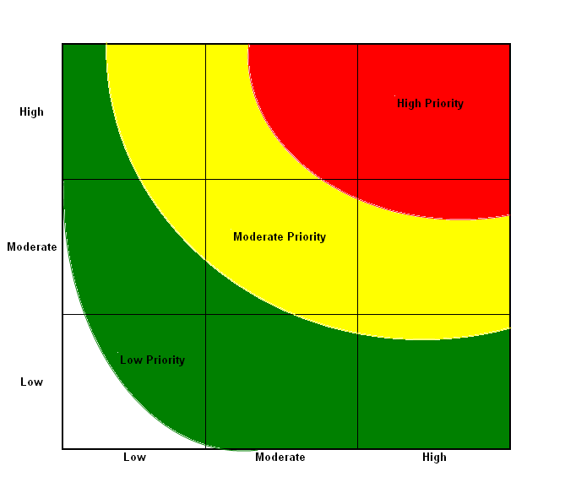
Risk Assessment– measured by Likelihood and significance
Risk assessment can also be used as part of the internal audit process to assess and rank the likelihood and significance of internal audit risks. A sample criteria could consider the following:
Likelihood:
Degree of Change - The degree of change the business process has experienced recently, internal management changes or entrance into new business areas.
Results of Previous Audits - The relative level of control as indicated in past internal audit activities related to the business process.
Human Resources - The stability of the group and the quality of service provided.
Process Complexity - The maturity of the business process and any known inherent risks, such as, the number of hand-offs between business units/departments, the complexity of related systems and the inter-relatedness of the process to other aspects of the business.
Significance:
Materiality - The relative value or importance of the objectives and risks related to the business process or activities, considering potential for fraud.
Management Concerns - Level of concern expressed by management.
SIGNIFICANCE
LIKELIHOOD

Slide 17
Risk Response
Having assessed relevant risks, management determines how it will respond.
Responses include risk avoidance, reduction, sharing and acceptance.
In considering its response, management considers costs and benefits, and selects a response that brings expected likelihood and impact within the desired risk tolerance.

Slide 18
Risk Response

Slide 19
Risk Response
Identify Risk Responses
Evaluate Possible Risk Responses
Select Response
Portfolio View
Avoid
Reduce
Share
Accept
Impact
Likelihood
Cost versus
benefit
Innovative
responses
Management
decision
Entity level
Business unit
level
Inherent and
residual basis

Slide 20
Control Activities
Control activities are the policies and procedures that help ensure that management’s risk responses are carried out. Control activities occur throughout the organization, at all levels and in all functions.
They include a range of activities as diverse as:
Approvals and authorizations – Hierarchy driven
Internal and external assurance
Periodic reviews at various levels
Consulting and specialists support
Industry and peer comparison

Slide 21
Control Activities
Integration with Risk Response
Types of Control Activities
General Controls
Application Controls
Entity-Specific
Build directly
into
management
processes
Interrelate
Policies
Procedures
Preventative
Detective
Manual
Automatic
Information
technology (IT)
management
IT infra-
structure
Security
management
Software
development &
maintenance
Completeness
Accuracy
Authorization
Validity
Entity specific
strategies and
objectives
Operating
environment
Complexity of
the entity

Slide 22
Information and Communication
Pertinent information is identified, captured and communicated in a form and timeframe that enable people to carry out their responsibilities.
Use internally data and information about external events, activities and conditions, providing information for managing risks and making informed decisions pro-actively.
Effective communication from top management on importance of enterprise risk management with clear role definition and accountability.
Facilitate two way communication – vital information often flows from customer and market contact.
Scanning and sharing of vital external information

Slide 23
Monitoring
Ongoing monitoring activities and continuous evaluation.
Bottom-up approach with dashboard for top management.
Periodic reporting to Board and stakeholders.
Revisit risks at least every six months and the framework at least once in two years.

Slide 24
Monitoring
Ongoing
Separate Evaluations
Reporting Deficiencies
Real-time
Built-in
Day-to-day operations
Scope
Frequency
Self-assessments/
internal auditors
Extent of
documentation
Ongoing
External parties
Protocols
Alternative channels

Slide 25
Balancing the Hard and Soft side of Risk Management
Hard Side
Soft Side
Measures and reporting
Risk oversight committees
Policies & procedures
Risk assessments
Risk limits
Audit processes
Systems
Risk awareness
People
Skills
Integrity
Incentives
Culture & values
Trust & communication

Slide 26
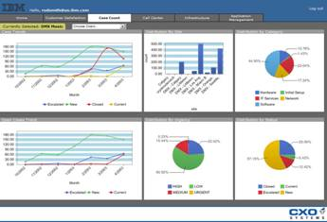
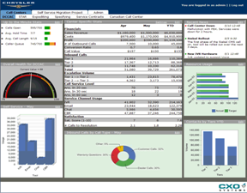
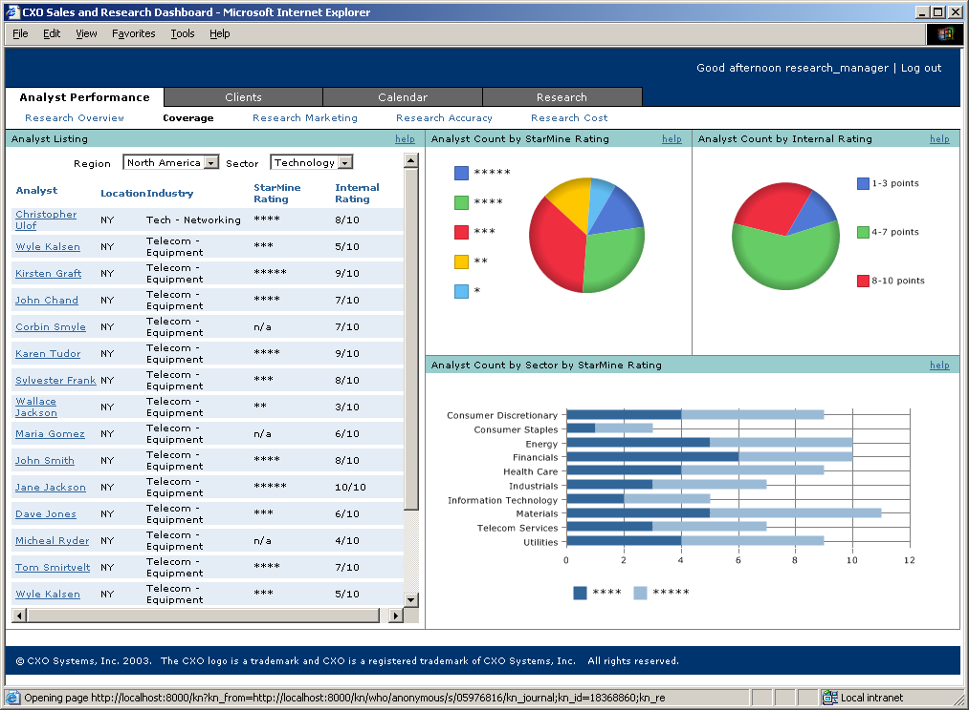
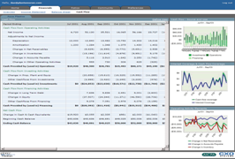
An ERM dashboard should provide full Risk Transparency
  Compliance with risk policies and regulations
    Exposures vs. policy limits
    Regulatory compliance
  Earnings-at-risk
    Major internal drivers
    Key external variables
  Risk/return performance tracking
    Business units
    Customer segments
    Products
  “Right time” risk reporting
    One touch visibility
    Drill down capabilities
    24x7 escalation
    Early warning signals

Slide 27
Business Risk Model - Example
External Risks
Internal Risks
Industry
Economy
Political change
Competitor
Consumer preference
Market share
Reputation
Brand equity
Strategic focus
Investor confidence
Strategic
Risks
Process Risks
Customer satisfaction
Product failure
Supply chain
Sourcing
Supplier concentration
Outsourcing
Production Cycle
Catastrophic loss
Process execution
People Risks
Human Resources
Health and safety
Authority
Integrity
Leadership/Empowerment
Communications
Culture
Performance incentive
Knowledge capital
Compliance Risks
Policies and procedures
Environmental
Contract
Legal and regulatory
Operations Risks
Treasury Risks
Cash flow/liquidity
Capital availability
Interest rate
Foreign exchange
Credit Risks
Credit capacity
Credit concentration
Credit default
Technological Risks
Systems infrastructure
Systems access
Systems availability
Data integrity
Date relevance
Finance
Risks
Financial Risks
Accounting
Budgeting
Taxation
Operational Risks
Pricing
Performance measurement
Portfolio
27
Notes:
27

Slide 28
Scope of ERM
Aligning risk appetite and strategy
Enhancing risk response decisions
Reducing operational surprises and losses
Managing multiple and cross enterprise risks
Highlighting opportunities to improve deployment of capital

Slide 29
Risk Card
Root Causes
Mismatch of customer expectations
  and speed
  entailing re engineering by vendors
  Inability to meet immediate resource requirements of the client
  Inability to deliver as per contractual obligations
  Promising much beyond ability
Leadership
Employee
Profitability
Customer
Shareholder
Risk Description
Customer Dissatisfaction
Mitigation/ Minimization Plan
Strategic
Responsibilities have been assigned to respective individuals. Personnel from delivery background would be account managers.
Resource requirements are periodically communicated to recruitment team.
Scope of work is signed and agreed by the client & Delivery Head. Work is also signed off by the client on completion of defined milestones.
Weekly/ fortnightly review meeting with customer.
Risk Category
Impact
Likelihood
Exposure
Inherent Evaluation
Key Performance Indicators
Business developed on the existing clients – i.e. – number / amount of new assignments.
Client satisfaction survey results
Residual Evaluation
Notes:
29

Slide 30
Risk summary report – key elements
Type of risk – strategic, operational, financial etc.
Brief description of risk
Rating – impact, likelihood and control effectiveness
Monitoring approach
Key risk management or containment activities
Gaps/issues/actions
Risk owner or accountable party
Processes, objectives, initiatives affected (interconnectivity)

Slide 31
Focus on Risks…
That can impact realization of future growth opportunities
That can impact core business operations that generate or support largest portion of revenue or profits today
That are inherent in certain activities…

Slide 32
Roadmap
Senior Management commitment
Chief Risk Officer – Facilitator
Framework
Risk appetite & threshold for each key risk
Defined owners
Board approval
Awareness & Training
Regular review
Notes:
32

Slide 33
Potential challenges….
Lack of senior management commitment.
Risk identification confused with enterprise risk management. Lack of common language and understanding of risk concepts.
Focus on selected businesses and strategies instead of the entire enterprise.
Inaction / complacency - It only happens to others
Challenges in obtaining relevant information and in a timely manner.
Risk management should not become “List management” !!!!!
Notes:
33

Slide 34
The bottom line…..
Enterprise Risk management must be a normal part of doing business and must be “built-in” to daily activities at all levels.
Successfully adopted, it helps the organization to develop a capability in managing risks so as to create, for every individual in the organization, an instinctive, consistent and recurring consideration of risk and reward in day-to-day planning and decision-making.
SEEK TO KNOW WHAT YOU DON’T KNOW!

Slide 35
Initial Steps
Evolved ERM
Risk Management Integration
Stakeholder Value
Enterprise-wide Risk Awareness
Unit Level Risks
Risk Management Sophistication
Enterprise-wide Risk Awareness
Risk management identified as a key objective of the strategic plan
Risk management mission statement developed
Role defined for Chief Risk Officer (CRO) and Divisional Risk Officers
Risk review meetings convened

Slide 36
Scaling Up
Evolved ERM
Risk Management Integration
Stakeholder Value
Enterprise-wide Risk Awareness
Unit Level Risks
Risk Management Sophistication
Risk Management Integration
Development of risk categorization framework
Definition of criteria for rating risk/ risk appetite at business level
Workshops for developing mitigation initiatives
Setting up of RM organization with responsibilities
Development of Risk management dashboard

Slide 37
Road Ahead
Evolved ERM
Risk Management Integration
Stakeholder Value
Enterprise-wide Risk Awareness
Unit Level Risks
Risk Management Sophistication
Evolved ERM
ERM becomes a consistent frame of reference across entire value chain and risk appetite constantly referred to during all key decisions
Clear linkages established between financial performance and risk assessments
Real time assurance systems in place covering key financial / operational risks

Slide 38
Risks…some thoughts
Risks and opportunities - two sides of the same coin
Charge your customer a premium for risks – making risk an element of pricing
Role of media and technology – reputation risk is getting increasingly challenging to manage.
Risk awareness is the key, complacency a threat! (It only happens to others!)
Fall of yesterday’s “Stars” – was absence of risk management an important cause?
Information Security….the worst is yet to come
Business continuity challenging despite technology advances!

Slide 39

Risk management is a
Continuous Journey……

Slide 40
Questions ???

Slide 41
Thank you for your attention!
Reach me – jyotinmehta@voltas.com

