Slide 1
Impact of Budget On Capital Markets
Ambareesh Baliga
February 4th, 2018

Slide 2
Run up to Budget
Last full Budget before General Elections 2019– 8 states to go to polls before General Elections in April/May 2019.
The case for fiscal expansion, which was quite strong in the past 4 years is now turning weak. Fiscal consolidation to continue. Fiscal deficit estimated to be 3.5% of GDP in FY18 and 3.2% in FY19
Themes perceived to benefit from the pre-election budget: a) rural consumption; b) urban consumption; c) affordable housing; and d) infrastructure boost.

Slide 3
What moved the markets
India second best performing market in the world (up 29 pct) after Hong Kong (up 36 pct)
Foreign flows to the tune of USD 7.5 bn in CY2017 (USD 3.7 bn and USD 3.3 bn in CY2016 and CY2015)
Domestic MFs pumped in INR 1.15trn compared to INR 294bn in CY2016
Moody's upgraded India’s sovereign rating upgraded after a period of 13 years in 2017.
A String of Electoral and Political gains for the ruling party
Govt announced Rs 2.1 trn for the recapitalisation for PSU banks
Govt initiatives and optimism in global markets
Neither demonetisation nor challenges in GST implementation deterred markets

Slide 4
Markets since Demonetisation

Slide 5
Key reforms in 2017
Increased government spending on rural housing and agriculture
Various initiatives on infrastructure building
GST implementation
Bank recapitalisation programme
Real Estate Reforms with introduction of ReRa and Affordable Housing Policy
Crackdown on Shell Firms
Compulsory linking with Adhaar

Slide 6
Key indices- how they fared

Slide 7
Flows into India- over the years
In USD bn | FPIs | DIIs
CY2007 | 18.5 | 6.0
CY2008 | -12.9 | 16.6
CY2009 | 17.6 | 5.3
CY2010 | 29.3 | -4.8
CY2011 | -0.5 | 5.9
CY2012 | 24.5 | -10.9
CY2013 | 19.8 | -12.9
CY2014 | 16.2 | -5.1
CY2015 | 3.3 | 10.3
CY2016 | 2.9 | 5.4
CY2017 | 7.7 | 13.9
Mutual Funds | Banks/FIs/Insurance
1.4 | 4.6
3.3 | 13.4
-1.2 | 6.5
-5.9 | 1.2
1.3 | 4.6
-3.8 | -7.0
-3.8 | -9.2
4.8 | -9.9
10.9 | -0.6
6.9 | -1.5
17.9 | -4.0

Slide 8
Virtuous Market Cycle
Equity gives good returns
Fresh Funds are Invested
Pushes the markets up further
Continues to give better returns
More Funds Comes in
Virtuous Cycle of Equity
Markets till it goes bust

Slide 9
Market Valuations
Low PE stocks delivered the worst returns, whereas high PE delivered the best returns. This is sharp contrast to the outperformance of low PE stocks over other quintiles in the last decade.
Market cap to GDP ratio is above 100 pct for the first time since 2007 and above long-term average of 80 pct.
Mid-cap valuations at a decade high compared to large-caps
Earnings yield is at all-time low of less than 3.5% (this was 4.5% in 2007)

Slide 10
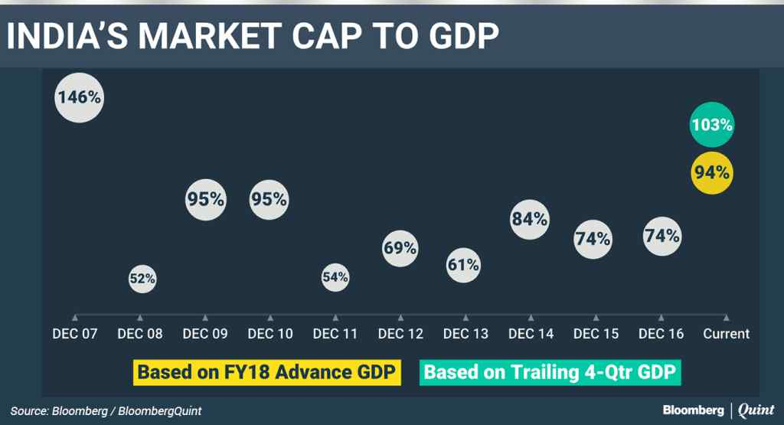
Market Valuation

Slide 11
Sentiment at peak

Slide 12
Pre-election year- a synopsis
Sr. No | Election Year | Major Challenges in pre-election year | Remarks
1. | 1990-91 | Crisis at the center, political uncertainty Short-lived governments India avoided Balance of Payment crisis by keeping gold as security Gulf war Rising crude oil prices | One of the most challenging years Worsening economy and world political crisis Domestic political challenges
2. | 1995-96 | Several government scandals Resignations of several cabinet members PM faced corruption charges Tense communal environment- riots, bomb blasts, Ayodhya issue | Considering Liberalization policies- economically not a very challenging year Politically challenging year

Slide 13
Pre-election year- a synopsis
Sr. No | Election Year | Major Challenges in pre-election year | Remarks
3. | 1997-98 | Political uncertainty and crisis at the center Short-lived governments Rising power of left parties Congress- the then biggest political party in disarray | Challenges faced by the economy due to indecisiveness of the previous two governments- Deve Gowda and Gujral Political uncertainties
4. | 1998-99 | Political uncertainty and crisis at the center Short-lived governments | 2 elections within span of one year- economic set-back Under performance of manufacturing sector Leading Companies unable to face global competition

Slide 14
Pre-election year- a synopsis
Sr. No | Election Year | Major Challenges in pre-election year | Remarks
5. | 2003-04 | Political stability Center had a government which lasted for 5 years Both the national parties were facing elections with strong pre-poll alliances Global crisis on the back of dot.com burst was just behind us | India Shining Seeds of the 4 year bull run were being sowed
6. | 2008-09 | World’s biggest financial crisis after 1929 Collapse of U.S financial markets impacting world economy Politically NDA now in disarray and Congress became a dominant force High inflation | Only pre-election year where stock markets gave negative returns Deep global financial crisis

Slide 15
Pre-election year- a synopsis
Sr. No | Election Year | Major Challenges in pre-election year | Remarks
7. | 2013-14 | Subdued growth, high inflation Several political agitation stalled normal functioning of government Various corruption charges on the government- Coal, telelom, mining, commonwealth games Telecom licenses of major players cancelled by courts | Coal & Gas crisis looming large leading to power generation issues NPA issue within banking sector esp. PSU banks
8. | 2018-19 | Stable and powerful government Passed various economic reforms – Challenges with GST implementation Demonetization related critics Corporate earnings in recovery phase | Reforms announced had a sentimentally positive impact India emerged one of the best business and investment destinations Booming stock markets globally

Slide 16
Union Budget Major Highlights
Deviating from fiscal consolidation path- fiscal deficit for FY18 slipped from 3.2% of GDP to 3.5% of GDP. For FY19, target set at 3.3% of GDP.
Imposed a long term capital gains tax on capital gains exceeding Rs 1 lakh at the rate of 10% without allowing the benefit of any indexation- expected revenue mobilisation to the tune of Rs 200 bn.
Modicare- Proposal to launch a flagship National Health Protection Scheme to cover more than 10 crore poor and vulnerable families
To achieve the target of doubling farmer income by 2022, budget has given more focus on providing better price support for all Crops – 1.5x MSP

Slide 17
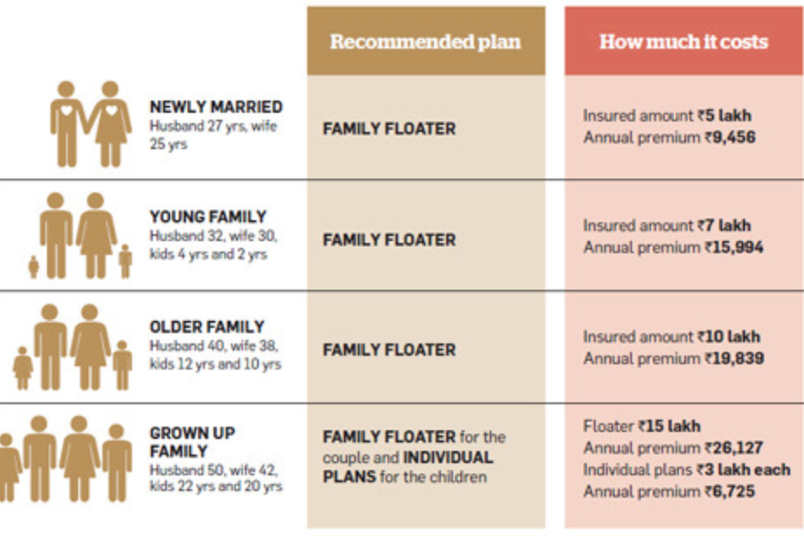
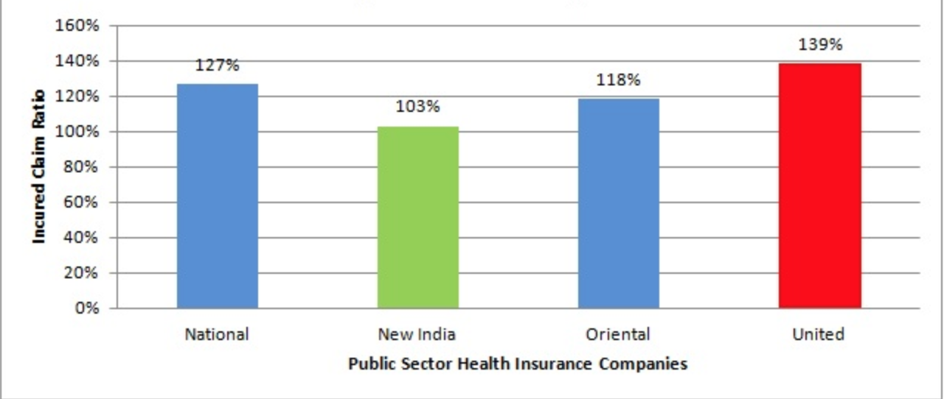
Is NHPS implementable?
A Family Floater costs ~2% of Insured amount. A Rs 5 lac family floater would have
costed Rs. 10,000 pa per Family
Government seems to be budgeting Rs. 1200/- per family.
Claim Ratio shows that PSU Health Insurance Co are incurring losses – So who will bell the cat?

Slide 18
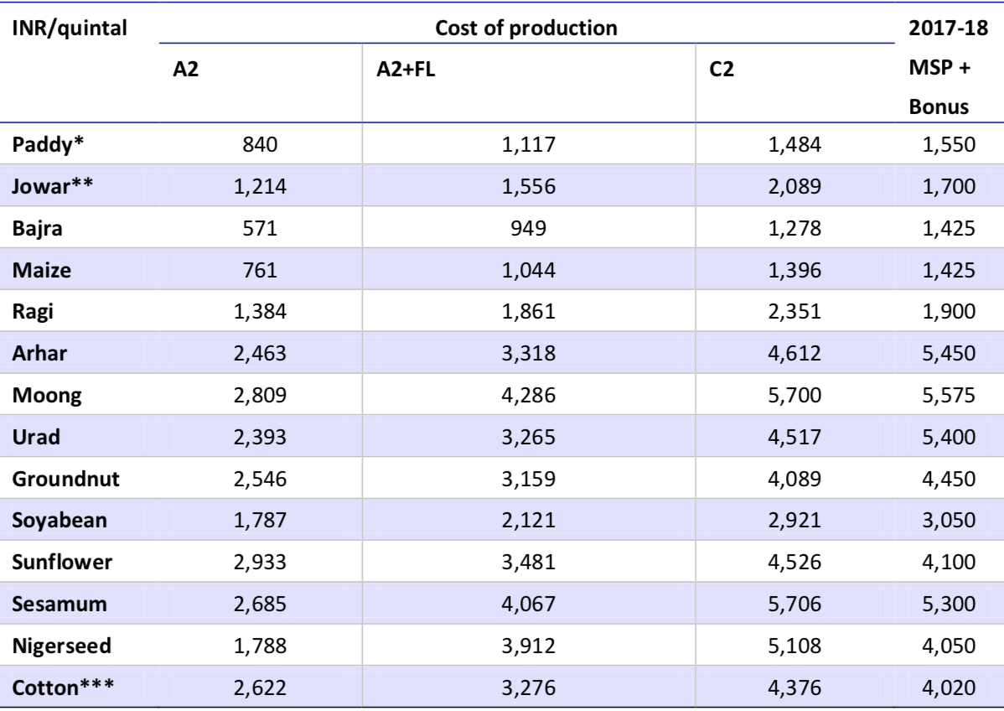
How will MSP be calculated?
^{Source: News article, MOSL}
A2 costs basically cover all paid-out expenses, both in cash and in kind, incurred by farmers on seeds, fertilisers, chemicals, hired labour, fuel, irrigation, etc.
A2+FL cover actual paid-out costs plus an imputed value of unpaid family labour.
C2 costs are more comprehensive, accounting for the rentals and interest forgone on owned land and fixed capital assets respectively, on top of A2+FL.

Slide 19
Union Budget Highlights
Prioritization of social infrastructure- Thrust has been given to farmers, rural population, senior citizens and underprivileged through various schemes and increased allocation of money
Increase in standard deduction to Rs 40,000- The revenue foregone of this decision is approximately Rs 80 bn.
Replace existing 3% education cess on personal income tax and corporation tax with a 4% ‘Health and Education Cess’. This will enable Government to collect an estimated additional amount of Rs 110 bn.
The dividend distribution tax on equity oriented mutual funds may net another Rs 75 bn

Slide 20
Union Budget highlights
Disinvestment target for FY19 is budgeted at Rs 800 bn while target for FY18 has been revised upwards to Rs 1000 bn from the budget estimate of Rs 725 bn.
A reduced corporate tax rate of 25% for companies that have reported turnover up to Rs 250 crore
Government will establish a dedicated Affordable Housing Fund (AHF) in National Housing Bank, funded from priority sector lending shortfall and fully serviced bonds authorized by the Government of India.
An Agri-Market Infrastructure Fund with a corpus of Rs 2,000 crore will be set up for developing and upgrading agricultural marketing infrastructure

Slide 21
Union Budget highlights
Proposal to merge the three public sector general insurance companies, and subsequently listed at the stock exchanges
Major subsidies will be increased by whopping 15.1% to Rs 2.64 lakh crore.

Slide 22
Expectations vs Reality
Sector | Key budget expectations | Actual delivery
Auto | Financial incentive to replace vehicles older than 10/15 years Long-term measures for agri sector to push farmer productivity/ income levels up Higher JNNURM (AMRUT) orders for bus manufacturers and incentives for EVs | MSP on kharif crops increased to 1.5x of cost of production Customs duty on truck and bus radial tyres increased from 10% to 15% Agri push to continue – Higher allocation to Agri + 15%, AMRUT +35%, Rural Infra +11%
Banking and Financial Services | Final blueprint and roadmap of mega recap plan to fund PSU banks Roadmap on merger plan of weak PSU banks Support for ‘Housing for All’ by 2022 Separate tax exemption for term life insurance Increased tax on life insurance companies, bringing it in line with current corporate tax rate | Setting up of a Affordable Housing Fund Corporates to borrow 25% of borrowing needs from bond market. Permits “A” rating as permissible eligibility for investment The government will soon announce measures for effectively addressing nonperforming assets and stressed accounts of MSME Mudra scheme target increased to INR 3 tn Interest Income exempt upto INR 50k for Senior Citizens

Slide 23
Expectations vs Reality
Sector | Key budget expectations | Actual delivery
Capital goods and Infrastructure | Higher budgetary allocation towards roads, railways, metro, defense and urban infra (AMRUT) projects | On the expected line- Increased capital outlay on Infrastructure sector by 21% YoY. Increased total allocation to Ministry of Road Transport & Highways by 10% YoY Increase in the total allocation to the Ministry of Civil Aviation by 52% YoY
Cement | Thrust on reviving rural economy through various incentives and higher infra spending | Increased capital outlay for overall Infrastructure (especially Roads, Railways) but lower allocation for PMAY)
FMCG & Retail | Outlining of reduction in corporate tax rate from 30% to 25% will benefit full tax paying companies Increased stimulus for rural India in the form of higher allocation to MNREGA and other rural employment initiatives Some relief to the jewellery industry in terms of lower custom duty on gold import (custom duty was increased from 2% to 10% in 2012-13) | Focus on rural development No increase of tax rate/cess on cigarettes. Increase in custom duty esp crude as well as Refined Oil, Juices, wrist watches, footwear etc. Comprehensive gold policy to be formed to make gold monetization scheme investment friendly

Slide 24
Expectations vs Reality
Sector | Key budget expectations | Actual delivery
Metals | Import duty on Aluminum to increase to10% from 7.5% Customs duty on coking coal to cut down to nil from 2.5% | No change in duty structure
Oil & Gas | Cut in cess rate for E&P companies (20% ad valorem currently) Inclusion of natural gas in GST (20-25% tax currently) Exemption in excise duty for CNG used for natural gas vehicles | For petrol and diesel, basic excise duty cut of Rs. 2/litre and abolition of additional excise duty of Rs. 6/litre gets offset by introduction of road and infrastructure cess of Rs. 8/litre. Petroleum Subsidy budgeted at INR 249 bn – (Brent Crude price of USD 51/bbl
Pharma | Extend R&D sunset clause (150% deduction on R&D) beyond 2020 Match GST refund rates to previous excise duty refund rates (20-25% lower currently) Implement proposed reduction in corporate tax rates to 25% in a phased manner for all domestic companies irrespective of turnover/ profit (currently limited to smaller companies) | The National Healthcare Policy to cover 10 crore poor families for health protection of hospitalisation increased to Rs. 5,00,000 (from earlier Rs. 30,000) per family per year

Slide 25
Expectations vs Reality
Sector | Key budget expectations | Actual delivery
Power | Uptick in Power T&D expenditure Inclusion of electricity under GST Down-scaling of clean energy cess | No change
Realty | Expanding beneficiaries of Pradhan Mantri Awas Yojana (PMAY) Further tax rationalization in REITs Increase deduction limit on housing interest and principal on housing loan | Increased total allocation to Ministry of Housing and Urban Affairs by 57% YoY No adjustments to be made where circle rate value does not exceed 5 pct of consideration
Telecom | Reduction in customs duty on equipment for timely roll-out of networks Relaxing withholding tax on distributors’ margin on SIM cards and prepaid vouchers Lowering GST on telecom services | Focus on optic fibre connectivity – increased to 250,000kms up from 155,000 – allocation of Rs. 100 bn Customs duty increased on handsets to 20%

Slide 26
What we need to watch out for
Fiscal Prudence in light of populist measures
Real Employment Generation
Recovery in earnings
Interest Rates & Inflation
Political Winds

Slide 27
Thank You

